Slide 1
International Finance HW4 – FX Market

Slide 2
Questions

Slide 3
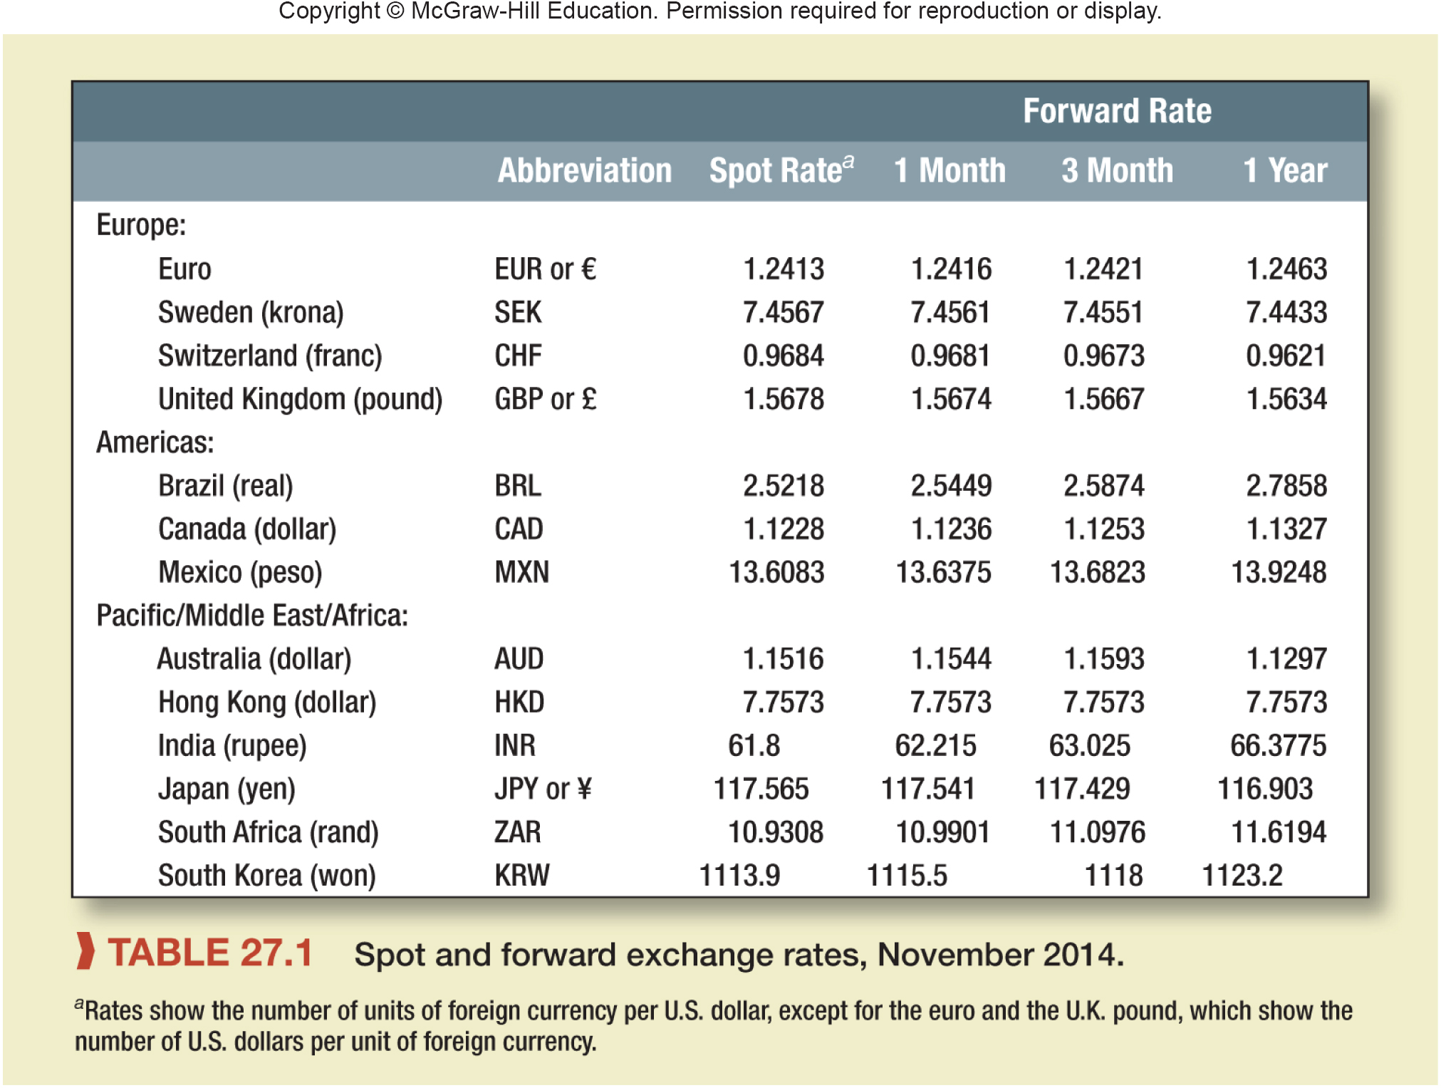
Question

Slide 4
Solution
a. 117.565
b. 117.541
c. Yen is at premium (dollar is at discount)
d. Premium = 117.565 / 116.903 – 1
Premium = .00566, or .566%
e. From interest rate parity:
116.903 / 117.565 = (1 + ryen) / 1.015
ryen = .00928, or .928%
f. ¥117.429 = $1
g. Assuming the real exchange rate is expected to be constant, the expected difference in inflation is:
117.429 / 117.565 – 1 = –.00116, or –.116%
The inflation rate in Japan over the three months is expected to be .116% less than in the United States.

Slide 5
Question

Slide 6
Solution
a.
First, find the NPV using the euro interest rate of 6%:
NPV = €80 + 10 / 1.06 + 20 / 1.062 + 23 / 1.063 + 27 / 1.064 + 25 / 1.065
NPV = €6.61 million
To convert this calculation to dollars, multiply it by the spot exchange rate:
NPV = €6.61 × 1.2 = $7.94 million

Slide 7
Solution
b.
The forward rate increases by the interest rate differential each year. The following table shows the forward rates for each of the next five years and adjusts the cash flow in each year.

Slide 8
Solution
c.
It doesn’t. The company can always hedge against a fall in the euro.

Slide 9
Question

Slide 10
Question

Slide 11
solution
a.
The dollar is selling at a forward premium on the rand.
b.
4 × (10.9308 / 11.0976 – 1) = −0.06012 = −6.012%
Annual percentage discount is 6.012%.
c.
Using the expectations theory of exchange rates, the forecast is: ZAR 11.0976 = $ 1
d.
ZAR100,000 × $1 / ZAR11.0976 = $9,010.96

Slide 12
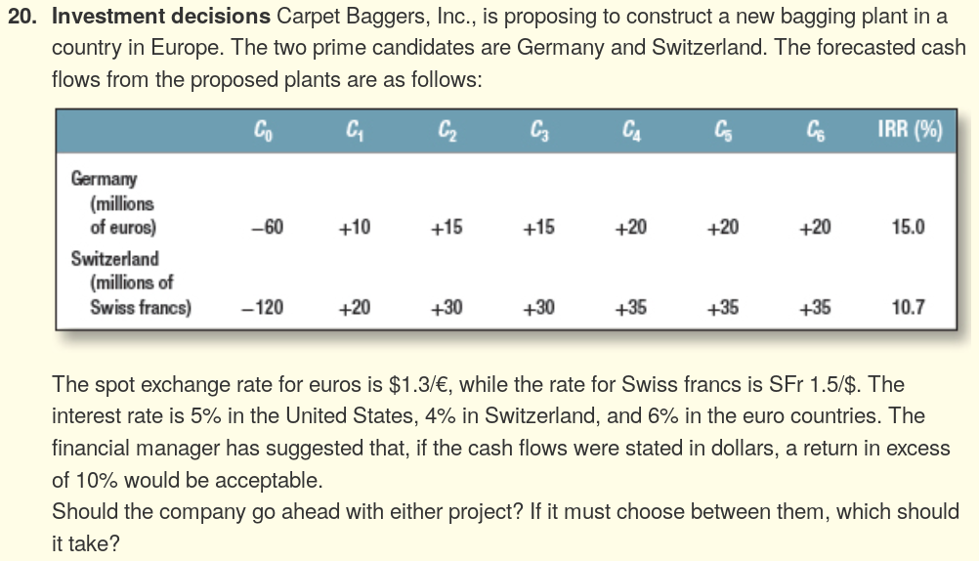
question

Slide 13
solution
Converting the cash flows to dollars, the NPVs are computed as:
NPV_{G} = –78 + 12.877 / 1.1 + 19.134 / 1.1^2 + 18.953 / 1.1^3 + 25.033 / 1.1^4 + 24.797 / 1.1^5 + 24.563 / 1.1^6
NPV_{G} = $10.12
NPV_{S} = –80 + 13.462 / 1.1 + 20.386 / 1.1^2 + 20.582 / 1.1^3 + 24.244 / 1.1^4 +24.477 / 1.1^5 + 24.712 / 1.1^6
NPV_{S} = $10.26
Since both projects have a positive NPV, both should be accepted. If the firm must choose, then the Swiss plant is the better choice. Note that the NPV calculation is in dollars and implicitly assumes currency hedging.

