Slide 1
Business Model Patterns

Slide 2
Business Model Patterns:
Osterwalder and Pigneur (2010) explain that business models with similar characteristics, similar building blocks or similar behavior, follow what is called “business model patterns.” In their book they describe five different business model patterns.

Slide 3
5 x Business Model Patterns
Unbundling
Long tail
Multi sided
Free
Open

Slide 4
1. UNBUNDLING

Slide 5
Unbundling Business Models
Customer Relationship Management
Product Innovation
Infrastructure Management
Hagel, J. Singer, M. 1999. Unbundling the Corporation. Harvard Business Review
1

Slide 6
Unbundling Business Models
Customer Services (SFR)
Content Provider (Tat)
Operations and Maintenance Outsourced (e.g. Siemens)
1

Slide 7
2. LONG TAIL

Slide 8
The Long Tail
Key
Partners
Key
Activities
Value Proposition
Customer Relationships
Customer Segments
Management
Services
Promotion
Niche Content Provider
Large Scope of Niche Content
Many Niche Segments
Key
Resources
Channels
GialloZafferano
Internet
VOX
Platform
Buzzfeed
Cost
Structure
Revenue
Streams
Platform
Management
Plus development
Selling less of More
Based on Osterwalder A. and Pigneur Y. 2010
2

Slide 9
3. MULTI-SIDED

Slide 10
Multi-sided Platform
Video Game Developer
Gamer
Vendors
Consumers
Advertisers
Users
Questions:
Which group of customers is more price sensitive?
Which customer segment should be subsidized?
Can we generate enough profit to compensate subsidies?
3

Slide 11
4. FREE

Slide 12
Free Business Model
Advertisement
Freemium
Bait & Hook
4

Slide 13
Freemium
Key
Partners
Key
Activities
Value Proposition
Customer Relationships
Customer Segments
Management
Services
Promotion
Automated and Mass customized
Free Basic Service
Large base of free users
Key
Resources
Channels
Premium Services
Small base of premium users
Internet
Platform
Cost
Structure
Revenue
Streams
It comes only from premium customers. It could be mixed with advertisement.
Fixed costs + Variable cost Basic Users + Variable costs Premium Users
Based on Osterwalder A. and Pigneur Y. 2010
4

Slide 14
5. OPEN

Slide 15
Open Business Models
Inside-out
The firm licenses or sell its intellectual property.
E.g. Red Hat
The firm brings ideas from outside
GlaxoSmithKline’s Patent Pool
Outside-in
Chesbrought, H. 2006.
5

Slide 17
1. UNBUNDLING

Slide 19
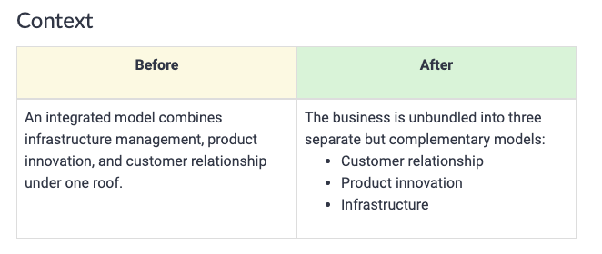

Slide 21
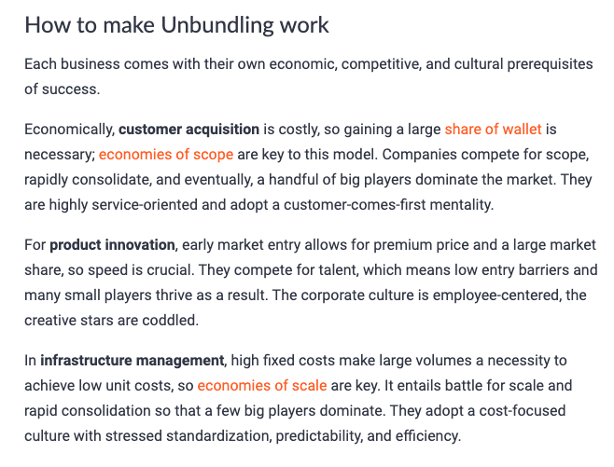

Slide 22
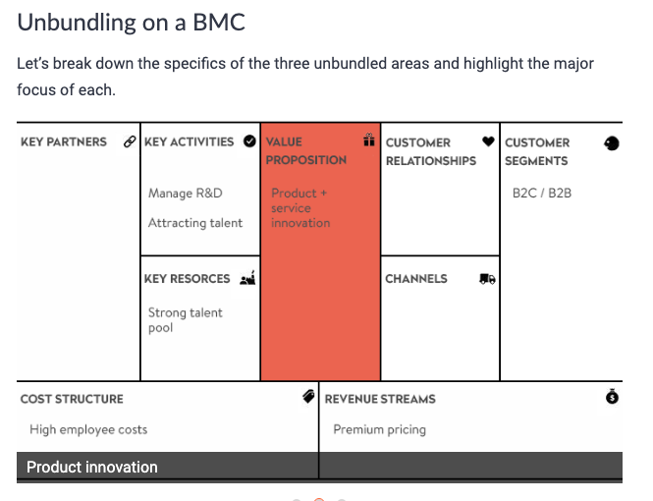
Product Innovation

Slide 23
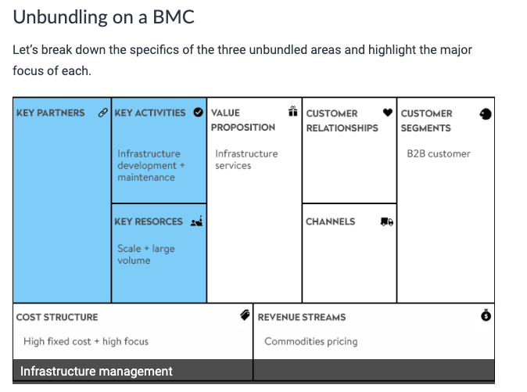
Infrastructure

Slide 24
Customer Relationship

Slide 26
2. LONG TAIL

Slide 29
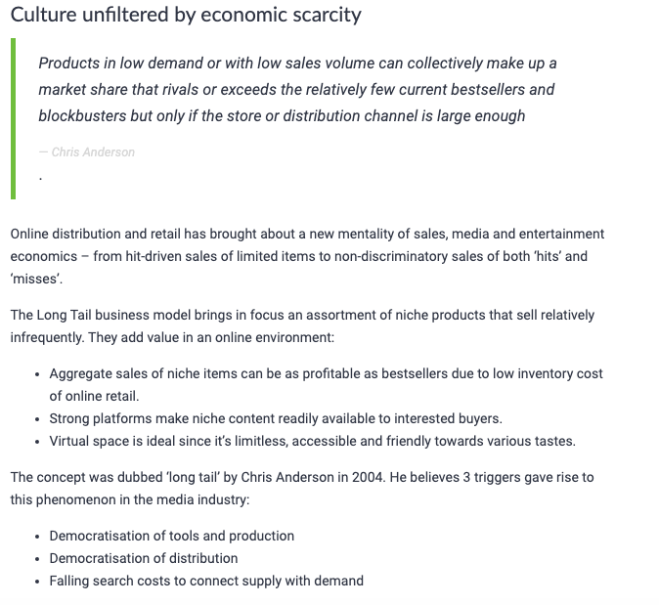

Slide 30
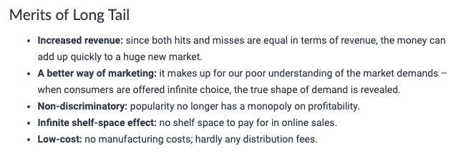

Slide 31
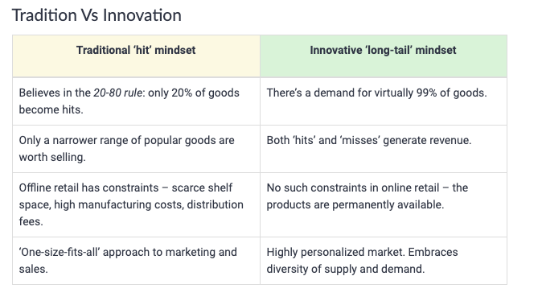

Slide 33
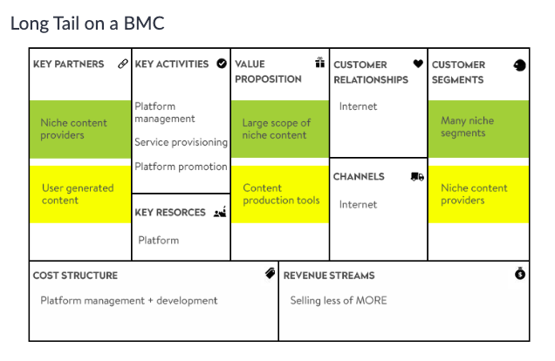

Slide 35
3. MULTI SIDED

Slide 36
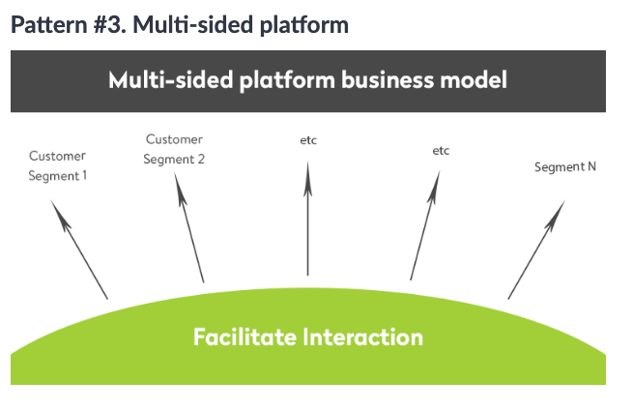

Slide 37
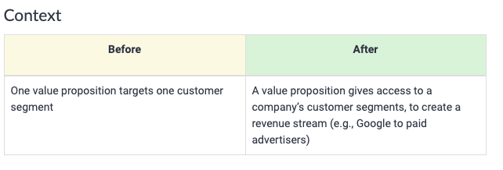

Slide 39
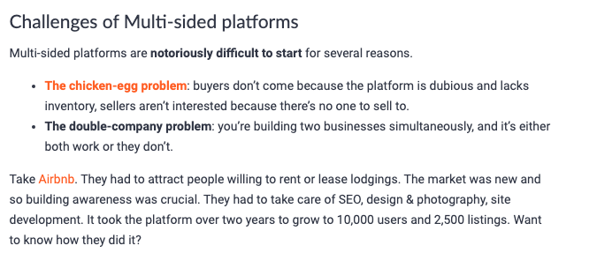

Slide 40
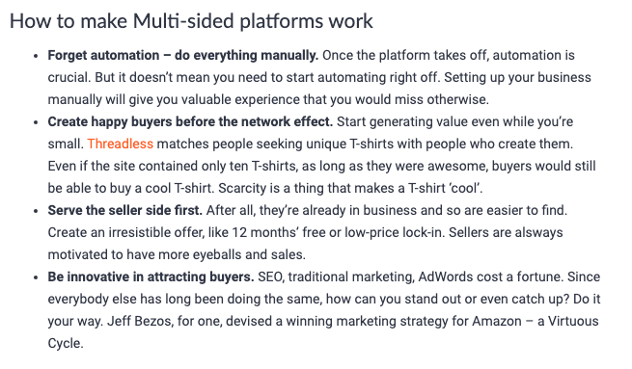

Slide 41
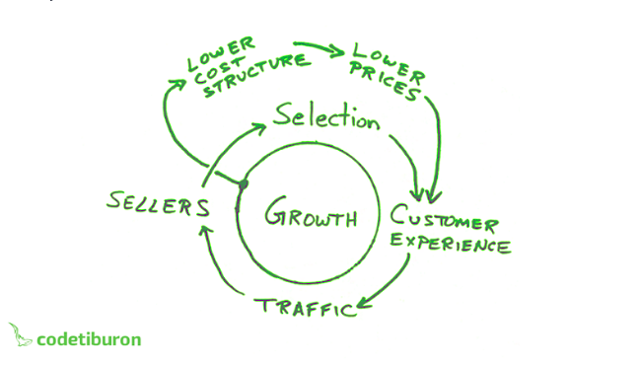

Slide 42
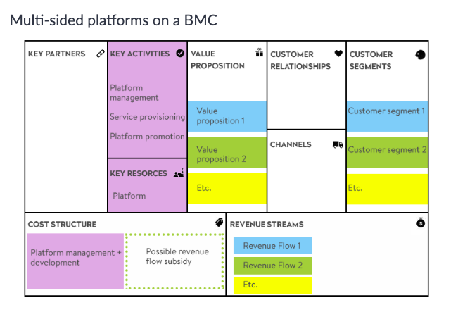

Slide 43
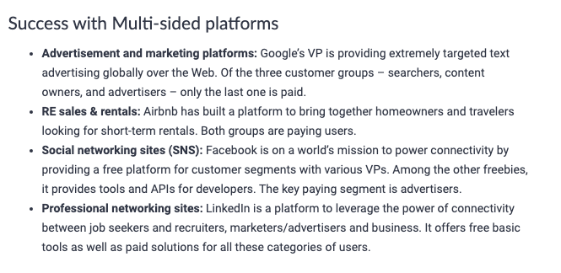

Slide 44
4. FREE

Slide 48
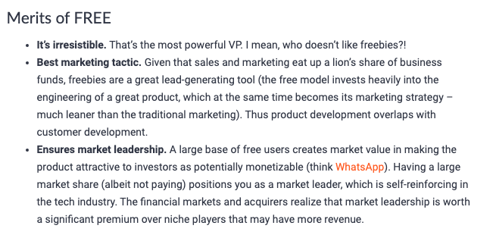

Slide 49
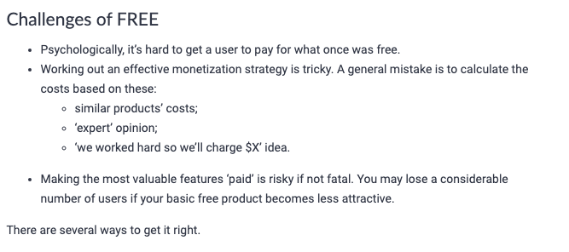

Slide 51
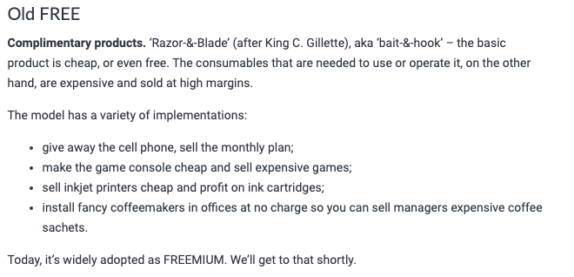

Slide 52
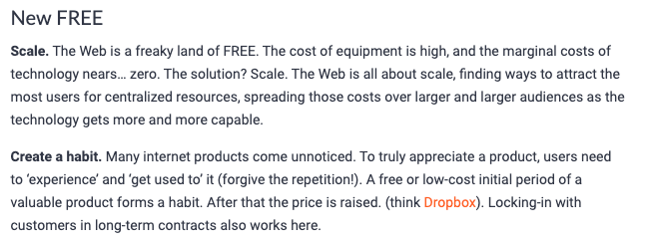

Slide 53
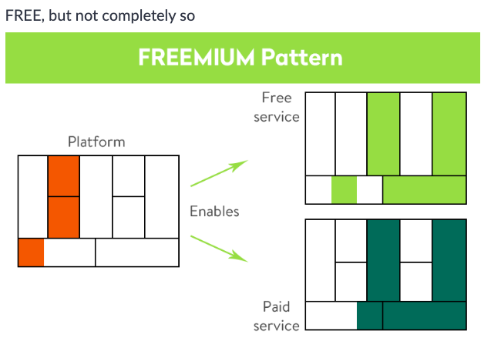

Slide 54
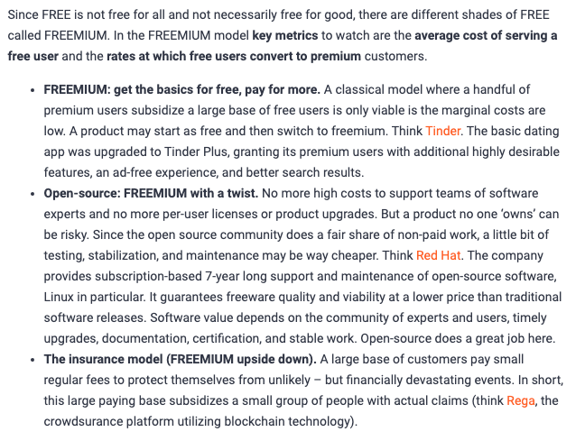

Slide 55
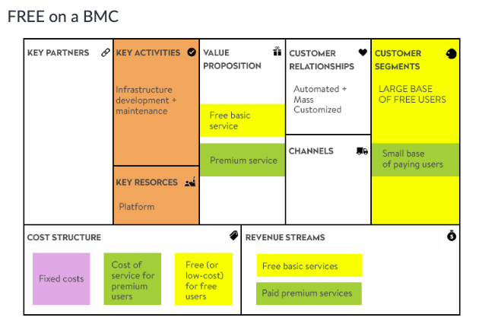

Slide 56
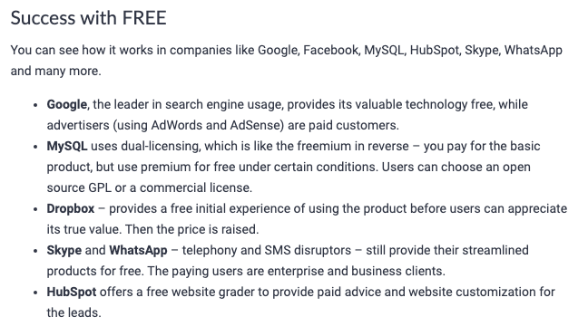

Slide 57
5. OPEN

Slide 59
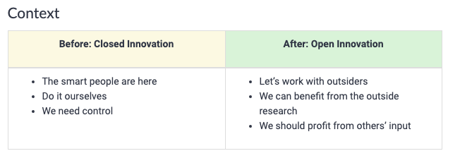

Slide 63
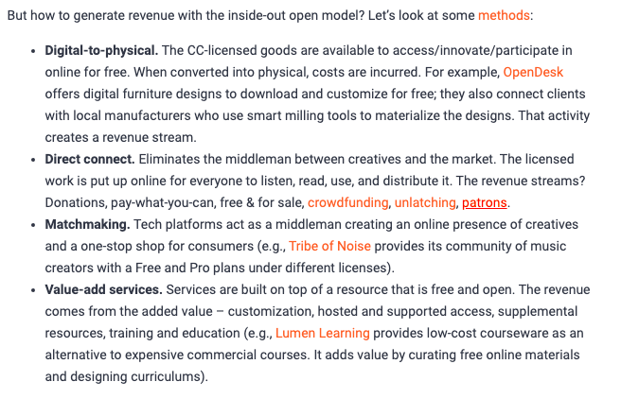

Slide 64
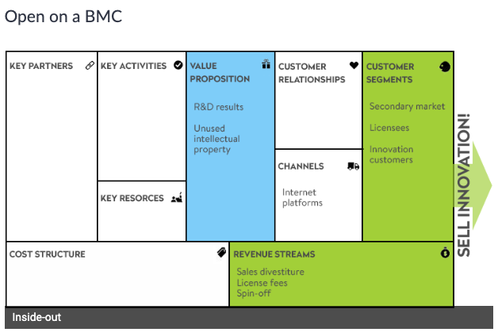

Slide 65
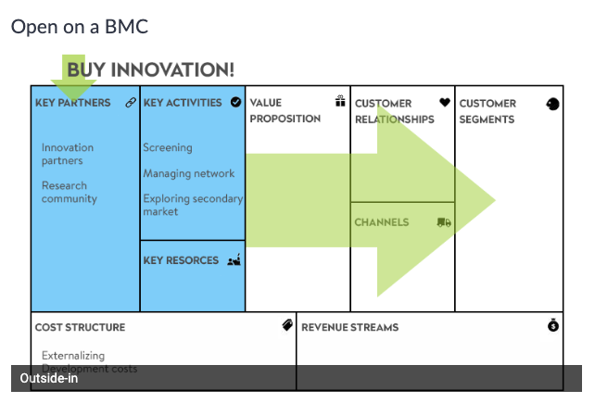

Slide 66
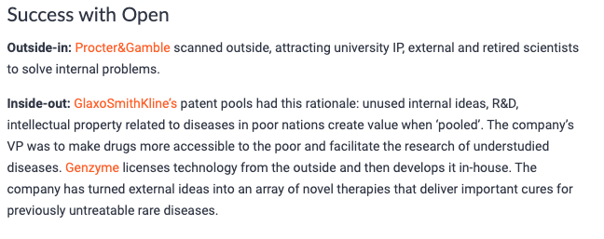

Slide 67
Thought

