Slide 1
Ecosystems

Slide 2
Why we talk about Ecosystems?
Development of IT
Regulation unbounding
Financial deregulation
Outsourcing to emergent countries.
Resource-based view
Analysis of capabilities
Evolutionary Analysis
Michael Porter’s Industry Analysis
80’S
90’S
00’S

Slide 3
Ecosystem
The term was used for the first time by the English botanist Arthur Tansley in an academic article in 1935. It was used to signify a basic ecological unit composed of both the environment and the organism that inhabit it.
Koening, G. “Business Ecosystems Revisited” p. 70 in Understanding Business Ecosystems, edited by Ben Letaifa, S. Gratacap, A and Isckia, T.
The original article reference:
Tansley, A.G. (1935) The use and abuse of vegetational concepts and terms. Ecology 16, 284–307.

Slide 4
Seminal Paper
Harvard Business Review
Predators and Prey: A New Ecology of Competition
by James F. Moore
FROM THE MAY–JUNE 1993 ISSUE
McKinsey Award for the best paper published in HBR
58 years after Tansley introduced the concept of Ecosystem
4 years before Nalebuff and Brandenburger article on Co-opetition

Slide 5
Business Ecosystems
In a business ecosystem, companies coevolve capabilities around a new innovation: they work cooperatively and competitively to support new products, satisfy customer needs, and eventually incorporate the next round of innovations.
Moore (1993)

Slide 6
Think about a Smartphone.
Instagram
WhatsApp
Tinder
Duolingo
SNCF
Spotify
Orange
SFR
Bouygues
Free Mobile
MVNOs
Apps
Operators
Aegis
Polva
FREE S.Speed
Shenzhen FU
Apple
Samsung
HTC
Nokia
Sony
Screen
Protectors
Builders

Slide 7
Business Ecosystems
An economic community supported by a foundation of interacting organizations and individuals – the organisms of the business world. This economic community produces goods and services of value to customers, who are themselves members of the ecosystem. The member organism also include suppliers, lead producers, competitors, and other stakeholders. Over time, they coevolve their capabilities and roles, and tend to align themselves with the direction set by one or more central companies. Those companies holding leadership roles may change over time, but the function of ecosystem leader is valued by the community because it enables members to move toward shared visions to align their investments, and to find mutually supportive roles. (Moore, 1996: 26)

Slide 8
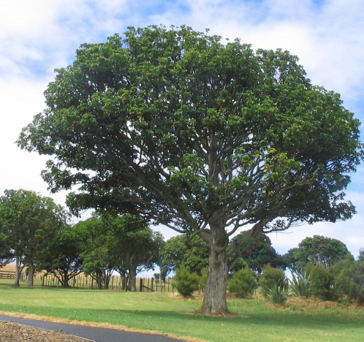
The Evolutionary Stages of a Business Ecosystem
Birth
Expansion
Cooperate
Co-opetition
Leadership
Self-Renewal
Compete
A new start?

Slide 9
The Evolutionary Stages of a Business Ecosystem
Birth
The focus is on cooperation
What the customers want?
A company leader should emerge
Its mission is to make the community larger
Cooperate
Established companies should e in a “wait & see” mode
Common goal or objective

Slide 10
The Evolutionary Stages of a Business Ecosystem
The goal is to expand the ecosystem
Expansion
Fighting with other ecosystems or co-existence are both possible
An ecosystem passes to the 2nd stage if:
There are many potential customers
It is possible to scale up.
Co-opetition
Stimulate the demand without exceeding the company’s ability to meet

Slide 11
The Evolutionary Stages of a Business Ecosystem
Does the ecosystem generate enough value to fight for?
Is the ecosystem structure reasonably stable?
Bargaining power with respect to suppliers and customers becomes very important.
Leadership
A key position is the “central ecological contributor”.
It is an essential stage for the leading companies.
Compete

Slide 12
The Evolutionary Stages of a Business Ecosystem
The last stage starts when the ecosystem is under threat by new ecosystems
Self-Renewal
Innovation is the key for the survival of the ecosystem
1
A new start?
Slow down
2
3
Incorporate
Restructure

