Slide 1
International Finance
Topic 3 – Foreign Exchange Market

Slide 2
Reference
“Principles of Corporate Finance”
  by Brealey, Meyers, Allen
  Chapter 27

Slide 3
Homeworks
Chapter 27 - Ex 1, 9, 10 & 20

Slide 4
Topics Covered
The Foreign Exchange Market
Some Basic Relationships
Hedging Currency Risk
Exchange Risk and International Investment Decisions
Political Risk
Notes:
3
2
2
2
2
2

Slide 5
Exchange Rates
November 2014

Slide 6
Foreign Exchange Markets
Exchange Rate - Amount of one currency needed to purchase one unit of another
Spot Rate of Exchange - Exchange rate for an immediate transaction
Forward Exchange Rate - Exchange rate for a forward transaction
Notes:
6
3

Slide 7
Foreign Exchange Markets
Forward Premiums and Forward Discounts
Example
The Brazil real spot price is 2.5218 real per dollar, and the 3-month forward rate is 2.5874 real per dollar. What is the premium and discount relationship?
Notes:
7
4

Slide 8
Foreign Exchange Markets
Example
The Brazil real spot price is 2.5218 real per dollar, and the 3-month forward rate is 2.5874 real per dollar.
Question
What is the premium and discount relationship?
Answer
Time
Notes:
8
5

Slide 9
Foreign Exchange Markets
Example
The Brazil real spot price is 2.5218 real per dollar, and the 3-month forward rate is 2.5874 real per dollar. What is the premium and discount relationship?
Answer - The dollar is selling at a 10.1% premium, relative to the real. The real is selling at a 10.1% discount, relative to the dollar.
    The Real is Depreciating against the $
    The $ is Appreciating against the Real
Notes:
9
6

Slide 10
Exchange Rates
Example
Swiss franc spot price is CHF 0.9684 per $1
Swiss franc 1 yr forward price is CHF 0.9621 per $1
Question
What is happening? Premium or Discount, which?
Notes:
10

Slide 11
Exchange Rates
Example
Swiss franc spot price is CHF 0.9684 per $1
Swiss franc 1 yr forward price is CHF 0.9621 per $1
Question
What is happening? Premium or Discount, which?
Answer
The franc is selling at a forward premium
The Dollar is selling at a forward discount
This means that the market expects the dollar to get weaker, relative to the franc
Notes:
11

Slide 12
Exchange Rates
Example
Swiss franc spot price is CHF 0.9684 per $1
Swiss franc 1 yr forward price is CHF 0.9621 per $1
Question
What is the franc premium (annualized)?
Notes:
12

Slide 13
Exchange Rates
Example
Swiss franc spot price is CHF 0.9684 per $1
Swiss franc 1 yr forward price is CHF 0.9621 per $1
Question
What is the franc premium (annualized)?
Answer
Notes:
13

Slide 14
Exchange Rates
Example (premium? discount?)
The South Africa rand spot price is 10.9308 per $1
The South Africa rand 1 yr fwd price is 11.6194 per $1
Question
What is the premium/discount?
What is the rand discount (annualized)?
Notes:
14

Slide 15
Exchange Rates
Example (premium? discount?)
The South Africa rand spot price is 10.9308 per $1
The South Africa rand 1 yr fwd price is 11.6194 per $1
Question
What is the premium/discount?
What is the rand discount (annualized)?
Answer
What is the rand discount (annualized)?
Notes:
15

Slide 16
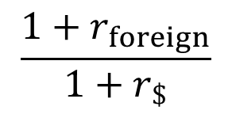
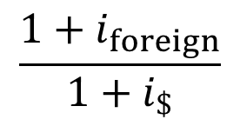
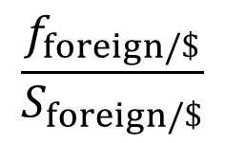
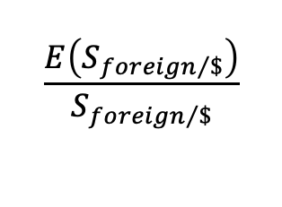
Exchange Rate Relationships
Basic Exchange Rate Relationships
r = risk free rate
i = inflation rate
equals
equals
equals
f = forward rate
E = expected spot rate
$$\frac{E\left(S_{{foreign}/\$}\right)}{S_{{foreign}/\$}}$$
equals
S = spot rate
S = spot rate
Notes:
16
7

Slide 17
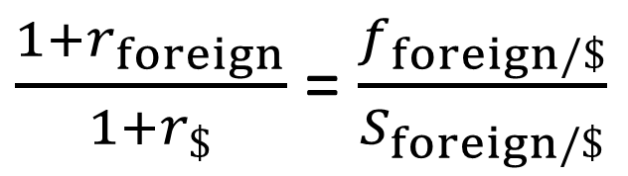
Exchange Rate Relationships
1) Interest Rate Parity Theory
The ratio between the risk-free interest rates in two different countries is equal to the ratio between the forward and spot exchange rates.
Notes:
17
8

Slide 18
Exchange Rate Relationships
1) Interest Rate Parity Theory
Example - You have the opportunity to invest $1,000 for one year in the U.S. at 5%. Ruritanian peso deposits are offering 15.5%. All other things being equal, the spot rate is RUP 50 per $1. The 1 year forward rate is RUP 55 per $1.
Which bond will you prefer and why?
Ignore transaction costs
Notes:
18
9

Slide 19
Exchange Rate Relationships
Example - You have the opportunity to invest $1,000 for one year in the U.S. at 5%. Ruritanian peso deposits are offering 15.5%. All other things being equal, the spot rate is RUP 50 per $1. The 1 year forward rate is RUP 55 per $1.
Which bond will you prefer and why? Ignore transaction costs.
Answer
Value of U.S. investment = $1,000 × 1.05 = $1,050
Value of RUP investment = $1,000 × 50 = 50,000 peso exchanged to pesos
50,000 peso × 1.155 = 57,750 peso investment return
57,750 peso / 55 = $1,050 exchanged to $
Notes:
19
14

Slide 20
Exchange Rate Relationships
1) Interest Rate Parity Theory
r = risk free rate
1.10
Note: 1.05 x 1.10 = 1.155
equals
f = forward rate
1.10
S = spot rate
Note: 50 x 1.10 = 55
Notes:
20
7

Slide 21
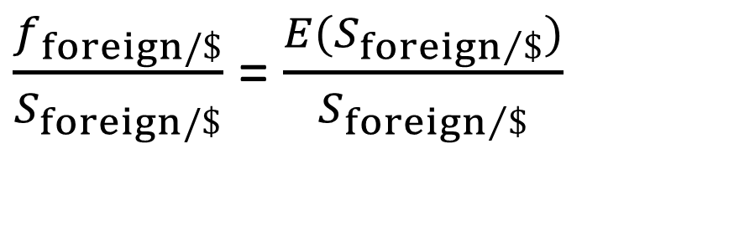
Exchange Rate Relationships
2) Expectations Theory of Exchange Rates
Theory that the expected spot exchange rate equals the forward rate.
Think of the word expected as being like the word forward the only difference being that you may know the forward rate but you don’t know the expected rate so you solve for it and it gives you an indication of what the forward rate is.
Notes:
21
15

Slide 22
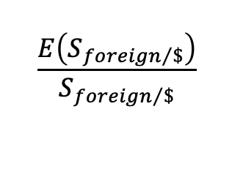
Exchange Rate Relationships
2) Expectations Theory of Exchange Rates
f = forward rate
E = expected spot rate
$$\frac{E\left(S_{{foreign}/\$}\right)}{S_{{foreign}/\$}}$$
equals
S = spot rate
S = spot rate
Notes:
22
7

Slide 23
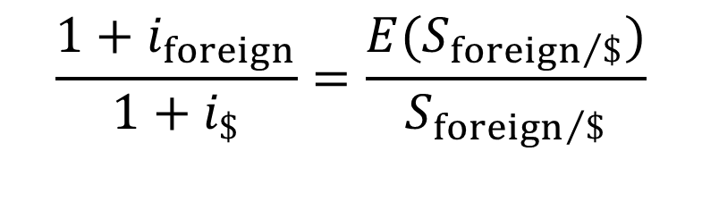
Exchange Rate Relationships
3) Purchasing Power Parity
Theory that the cost of living in different countries is equal and that exchange rates adjust to offset inflation differentials across countries.
Notes:
23
16

Slide 24
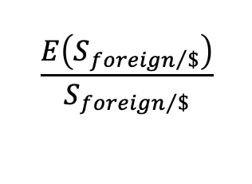
Exchange Rate Relationships
3) Purchasing Power Parity
i = inflation rate
equals
E = expected spot rate
$$\frac{E\left(S_{{foreign}/\$}\right)}{S_{{foreign}/\$}}$$
S = spot rate
Notes:
24
7

Slide 25
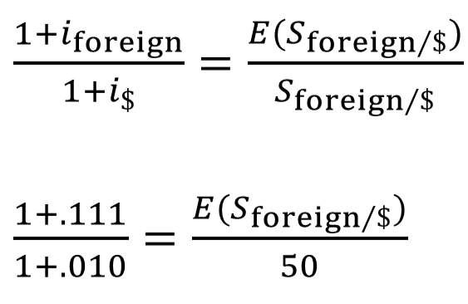
Exchange Rate Relationships
Example - If inflation in the U.S. is forecasted at 1.0% this year and Ruritania is forecasted at 11.10%. Given a spot rate of 50 peso:$1, what is the Expected Spot rate?
Solve for E(S_{foreign/$)}
55 = E(S_{foreign/$)}
Notes:
25
20

Slide 26
Exchange Rate Relationships
4) International Fisher effect
r = risk free rate
i = inflation rate
equals
The expected difference in inflation rates equals the difference in current interest rates.
Also called common real interest rates
Notes:
26
7

Slide 27
Exchange Rate Relationships
r = risk free rate
i = inflation rate
equals
Example - The real interest rate in each country is about the same
Notes:
27
23

Slide 28
Exchange Rates
Example
You are doing a project in Switzerland which has an initial cost of $100,000. All other things being equal, you have the opportunity to obtain a 1 year Swiss loan (in francs) @ 6.0% or a 1 year US loan (in dollars) @ 6.8%. The spot rate is 1.0723 chf:$1 The 1 year forward rate is 1.0643 chf:$1.
Question
Which loan will you prefer and why? Ignore transaction costs.
Notes:
28

Slide 29
Exchange Rates
Example
You are doing a project in Switzerland which has an initial cost of $100,000. All other things being equal, you have the opportunity to obtain a 1 year Swiss loan (in francs) @ 6.0% or a 1 year US loan (in dollars) @ 6.8%. The spot rate is 1.0723 chf:$1 The 1 year forward rate is 1.0643 chf:$1.
Question
Which loan will you prefer and why? Ignore transaction costs.
Cost of U.S. loan = $100,000 × 1.068 = $106,800
Cost of Swiss loan = $100,000 × 1.0723 = 107,230 chf
107,230 chf × 1.06 = 113,664 chf total loan pmt in one year in chf
113,664 chf / 1.0643 = $106,797
If the two loans created a different result, arbitrage exists!
Notes:
29

Slide 30
Exchange Rate Relationships
Basic Exchange Rate Relationships
r = risk free rate
i = inflation rate
equals
equals
equals
f = forward rate
E = expected spot rate
$$\frac{E\left(S_{{foreign}/\$}\right)}{S_{{foreign}/\$}}$$
equals
S = spot rate
S = spot rate
Notes:
30
7

Slide 31
Exchange Rates
% Forecast Error in Forward Rate for U.K. Pounds

Slide 32
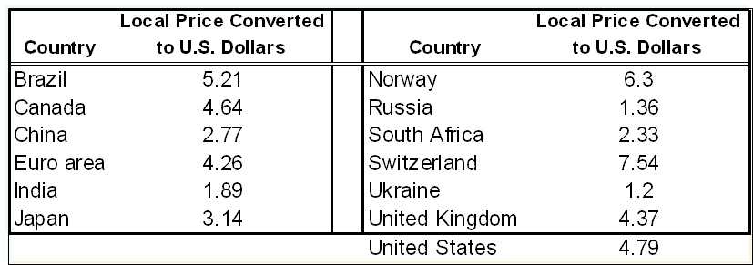
International Prices
The Big Mac Index – The price of a Big Mac in different countries (January 22, 2015)

Slide 33
International Prices
How much is a Louis Vuitton Bag in Paris? In New York?
How much is an Apple iPhone 11 Pro in Paris? In New York?
What is today’s exchange rate $/€ 1.08 €/$: 0.926
iPhone 11 Pro in Paris: €1,159 X 1.08 = $1,251.72
iPhone 11 Pro in New York: $999 X 0.926 = €925.07

Slide 34
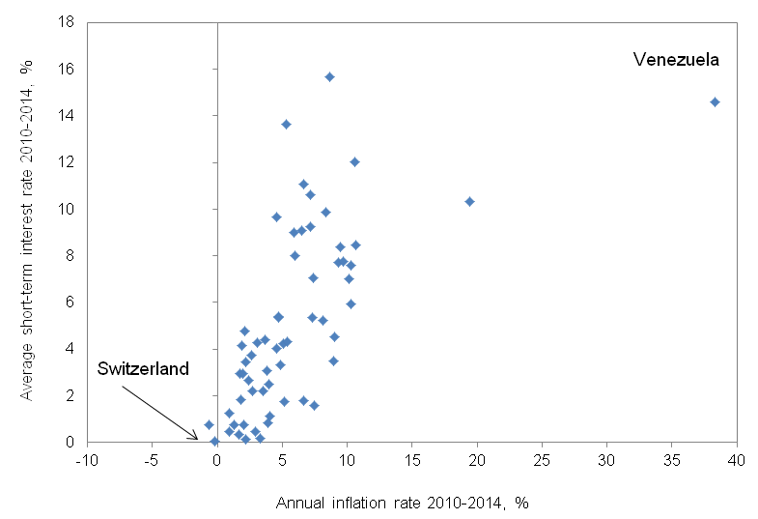
Interest Rates and Inflation
Countries with the highest interest rates generally have the highest inflation rates. In this diagram each of the 55 points represents a different country.

Slide 35
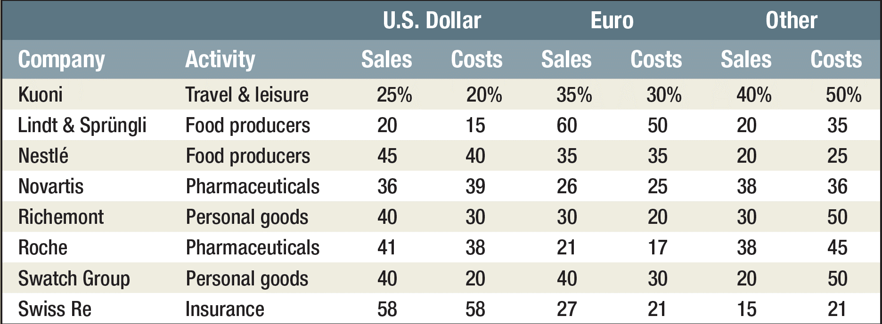
Swiss Corporate Data
The proportion of sales and costs for major Swiss companies that derive from particular currency areas

Slide 36
Exchange Rate Risk
Example - Harley Davidson builds a motorcycle for a cost plus profit of $12,000 or it sells at a price of $12,000 which includes it’s costs and profits.
At an exchange rate of 94.705Y:$1, the motorcycle sells for 1,136,460 yen in Japan.
If the dollar rises in value and the exchange rate is 103Y:$1, what will the motorcycle cost in Japan?
Notes:
36
27

Slide 37
Exchange Rate Risk
Example - Harley Davidson builds a motorcycle for a cost plus profit of $12,000 or it sells at a price of $12,000 which includes it’s costs and profits.
At an exchange rate of 94.705Y:$1, the motorcycle sells for 1,136,460 yen in Japan.
If the dollar rises in value and the exchange rate is 103Y:$1, what will the motorcycle cost in Japan?
Answer
$12,000 x 103 = 1,236,000 yen
Notes:
37
27

Slide 38
Exchange Rate Risk
Currency risk can be reduced by using various financial instruments
Currency forward contracts, futures contracts, and even options on these contracts are available to control the risk
Notes:
38
29

Slide 39
Capital Budgeting
Techniques
1) Exchange to $ and analyze
2) Discount using foreign cash flows and interest rates, then exchange to $
3) Choose a currency standard ($) and hedge all non-dollar CF
Notes:
39
30

Slide 40
Example
Suppose that the Swiss pharmaceutical company Roche is evaluating a proposal to build a new plant in the United States. To calculate the project’s net present value, Roche forecasts the following dollar cash flows from the project. The U.S. cost of capital is 12%, and the spot exchange rate is 1.2sf / 1$.
year 0 1 2 3 4 5
-$1,300 $400 $450 $510 $575 $650
Question
What is the project NPV value in U.S. dollars and Swiss francs?
Notes:
40

Slide 41
Example
Suppose that the Swiss pharmaceutical company Roche is evaluating a proposal to build a new plant in the United States. To calculate the project’s net present value, Roche forecasts the following dollar cash flows from the project. The U.S. cost of capital is 12%, and the spot exchange rate is 1.2sf / 1$.
year 0 1 2 3 4 5
-$1,300 $400 $450 $510 $575 $650
Question
What is the project value in U.S. dollars and Swiss francs?
Answer
year 0 1 2 3 4 5
-$1,300 + $400 + $450 + $510 + $575 + $650
NPV ($) =
1.12¹
1.12²
1.12³
1.12⁴
1.12⁵
NPV ($) = $ 513 million
NPV (sf) = $513 × 1.2 (sf/$) = 616 million sf
Notes:
41

Slide 42
Example
Suppose that the Swiss pharmaceutical company Roche is evaluating a proposal to build a new plant in the United States. To calculate the project’s net present value, Roche forecasts the following dollar cash flows from the project. The U.S. cost of capital is 12%, and the spot exchange rate is 1.2sf / 1$.
Question
What are the forward rates in each year if risk-free rates are U.S. = 6% and Swiss = 4%?
year 0 1 2 3 4 5
-$1,300 $400 $450 $510 $575 $650
Notes:
42

Slide 43
Exchange Rate Relationships
1) Interest Rate Parity Theory
r = risk free rate
equals
f = forward rate
S = spot rate
Notes:
43
7

Slide 44
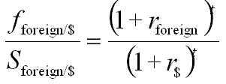
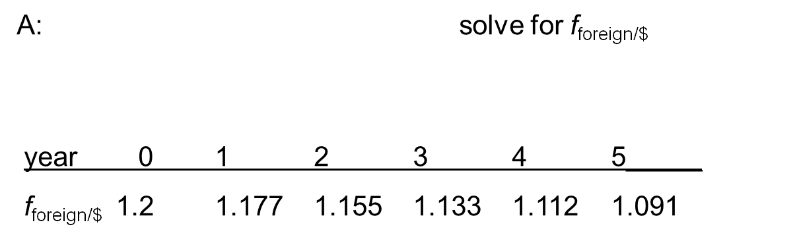
Example
Suppose that the Swiss pharmaceutical company Roche is evaluating a proposal to build a new plant in the United States. To calculate the project’s net present value, Roche forecasts the following dollar cash flows from the project. The U.S. cost of capital is 12%, and the spot exchange rate is 1.2sf / 1$.
Question
What are the forward rates in each year if risk-free rates are U.S. = 6% and Swiss = 4%??
Answer
Notes:
44

Slide 45
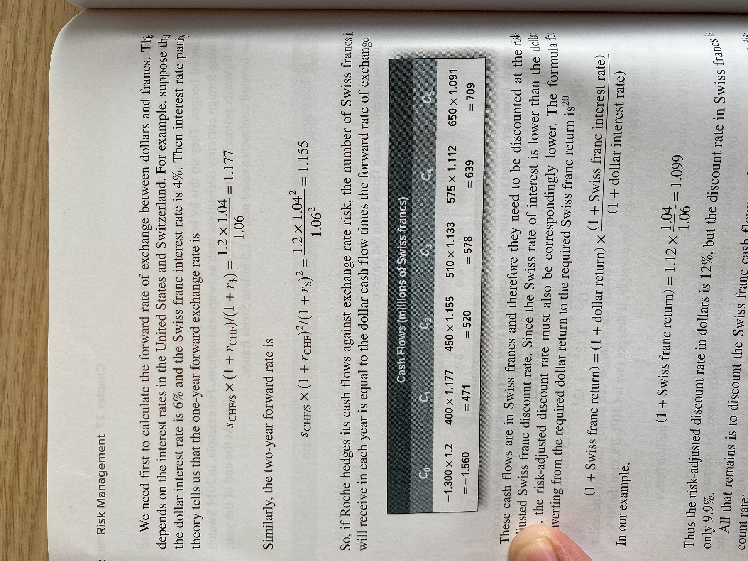
Example
Suppose that the Swiss pharmaceutical company Roche is evaluating a proposal to build a new plant in the United States. To calculate the project’s net present value, Roche forecasts the following dollar cash flows from the project. The U.S. cost of capital is 12%, and the spot exchange rate is 1.2sf / 1$.
Question
What are the forward rates in each year if risk-free rates are U.S. = 6% and Swiss = 4%??
Answer
Notes:
45

Slide 46
Example
Suppose that the Swiss pharmaceutical company Roche is evaluating a proposal to build a new plant in the United States. To calculate the project’s net present value, Roche forecasts the following dollar cash flows from the project. The U.S. cost of capital is 12%, and the spot exchange rate is 1.2sf / 1$.
Question
What are the cash flows in each year, given the forward rates?
Notes:
46

Slide 47
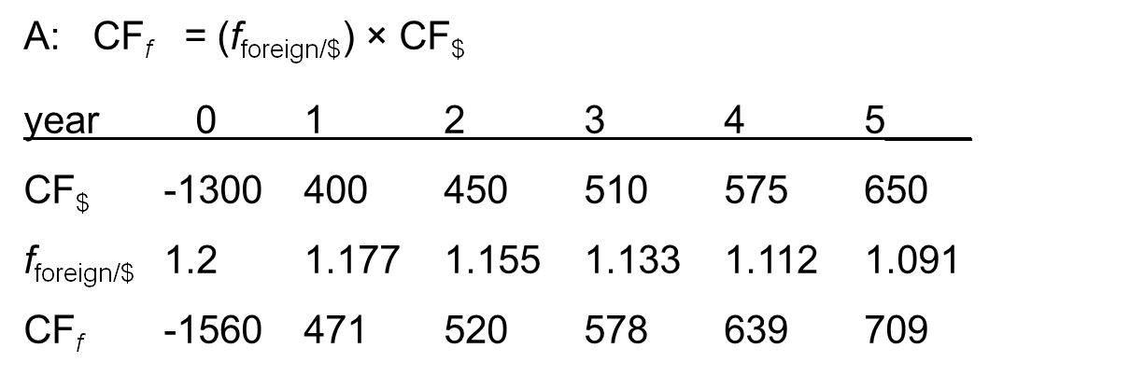
Example
Suppose that the Swiss pharmaceutical company Roche is evaluating a proposal to build a new plant in the United States. To calculate the project’s net present value, Roche forecasts the following dollar cash flows from the project. The U.S. cost of capital is 12%, and the spot exchange rate is 1.2sf / 1$.
Question
What are the cash flows in each year, given the forward rates?
Answer
Notes:
47

Slide 48
Example
Suppose that the Swiss pharmaceutical company Roche is evaluating a proposal to build a new plant in the United States. To calculate the project’s net present value, Roche forecasts the following dollar cash flows from the project. The U.S. cost of capital is 12%, and the spot exchange rate is 1.2sf / 1$.
Question
What is the NPV of the project in Swiss francs?
Notes:
48

Slide 49
Example
Question
What is the NPV of the project in Swiss francs?
Answer, Part 1:
Solve for Swiss Franc return
Notes:
49

Slide 50
Exchange Rate Relationships
Basic Exchange Rate Relationships
r = risk free rate
i = inflation rate
equals
Notes:
50
7

Slide 51
Example
Question
What is the NPV of the project in Swiss francs?
Answer, Part 1:
Solve for Swiss Franc return
1+ Swiss Franc return = 1+ dollar return x (1+Swiss Franc interest rate/1+dollar interest rate)
OR
1 + Swiss Franc return = 1.12 x (1.04/1.06) = 1.099
OR
Swiss Franc return = 1.099 - 1
OR
Swiss Franc return = .099 = 9.9%
Notes:
51

Slide 52
Example
Question
What is the NPV of the project in Swiss francs?
Answer, part 2
year 0 1 2 3 4 5
-1560 + 471 + 520 + 578 + 639 + 709
NPV (CF) =
1.099¹
1.099²
1.099³
1.099⁴
1.099⁵
NPV (CF) = 616 million francs
Notes:
52

Slide 53
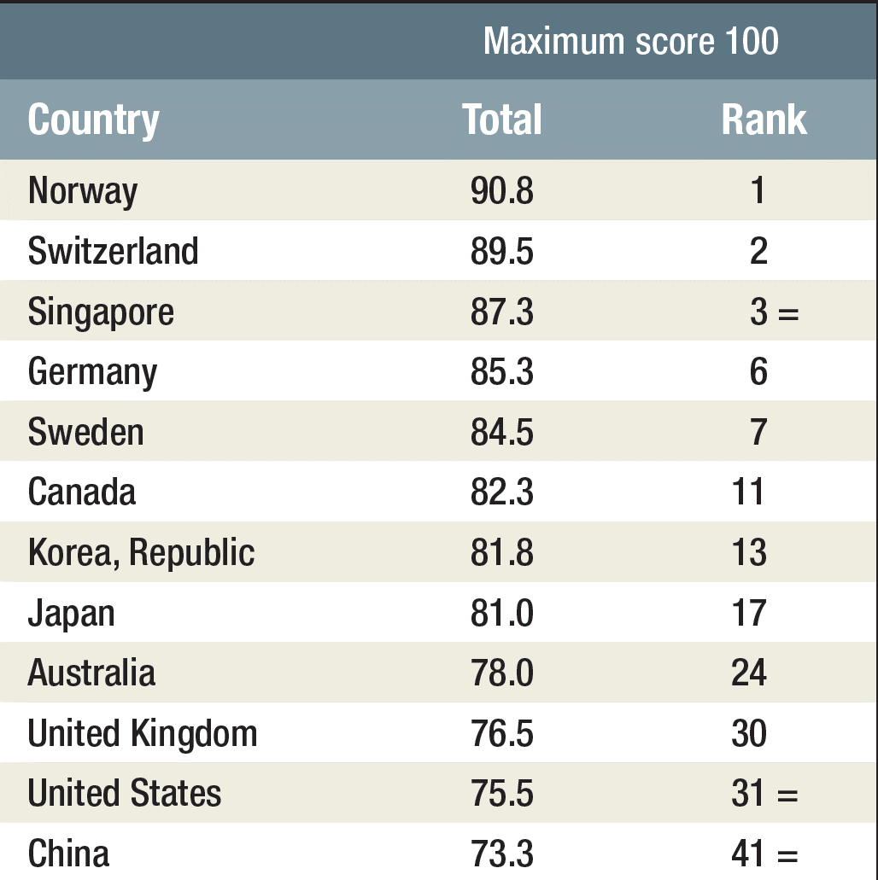

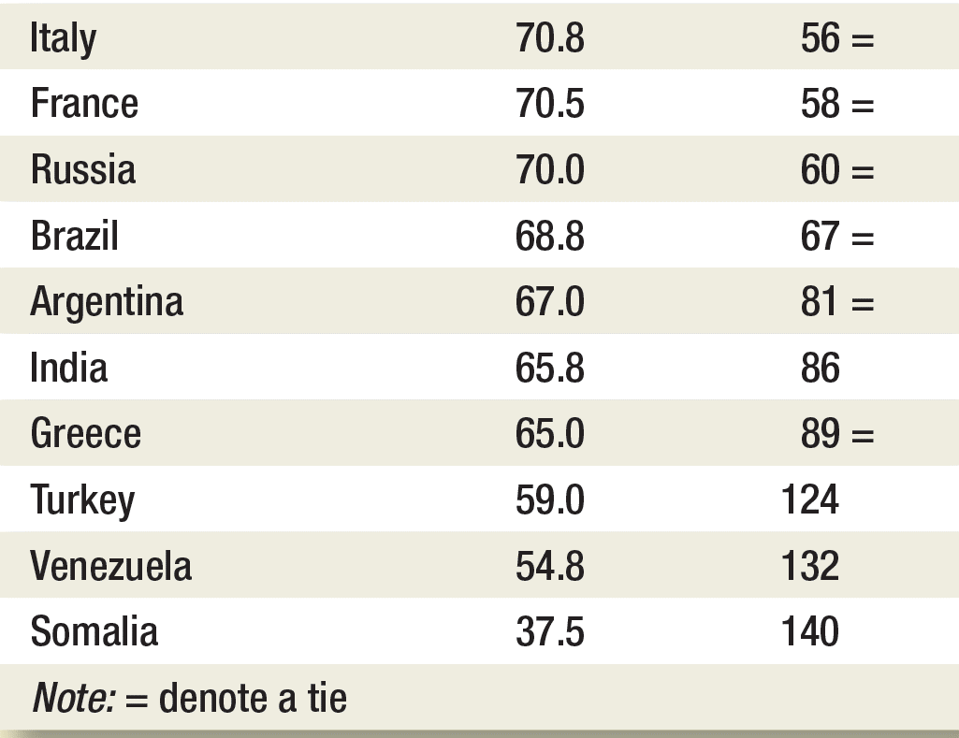
Political Risk

Slide 54
RE-READ
“Principles of Corporate Finance”
  by Brealey, Meyers, Allen
  Chapter 27

Slide 55
REDO Homework
Chapter 27 - Ex 1, 9, 10 & 20

Slide 56
Homework - READ
“Principles of Corporate Finance”
  by Brealey, Meyers, Allen
  Chapter 20 & 26

Slide 57
Homework – to do
Chapter 20 ex 1,2,3,6,7,10
Chapter 26 ex 2,3,4,5
Watch the movie “Inside Job” (US-2010) !

Slide 59
Reference
“Principles of Corporate Finance”
  by Brealey, Meyers, Allen
  Chapter 27

Slide 60
Homeworks
Chapter 27 - Ex 1, 9, 10 & 20

