Slide 1
INTERNATIONAL FINANCE HW2 – Balance of Payments

Slide 2
Questions

Slide 3
Questions

Slide 4
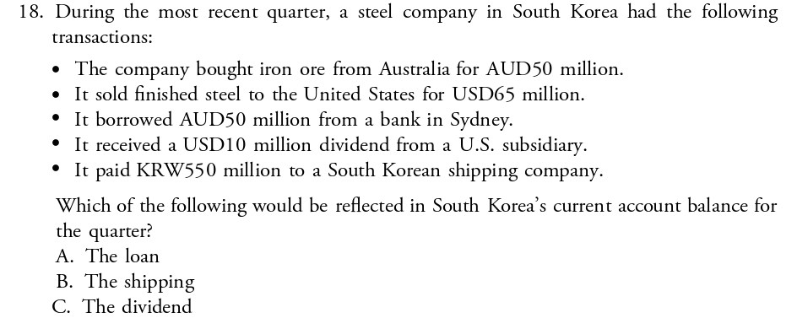
Question

Slide 5
QUICK REVIEW
The current account measures international trade of goods and services plus net income and transfer payments.
The capital account measures financial transactions that don't affect income, production, or savings. Examples include international transfers of drilling rights, trademarks, and copyrights.
The financial account measures the increases or decreases in international ownership assets that a country is associated with.
Notes:
Current Account: https://youtu.be/dirBYVjDk7A
Capital Account: https://youtu.be/AimYG1jYD0A
Why the Current Account and Capital Account net out:
https://youtu.be/tYmMEqro8D4
Financial Account:

