Slide 1
STRICTLY CONFIDENTIAL
Investment Banking, 2E USER GUIDE Discounted Cash Flow Analysis
JOSHUA ROSENBAUM & JOSHUA PEARL

Slide 2
Copyright © 2013 by Joshua Rosenbaum and Joshua Pearl. All rights reserved.
Published by John Wiley & Sons, Inc., Hoboken, New Jersey.
Published simultaneously in Canada.
No part of this publication may be reproduced, stored in a retrieval system, or transmitted in any form or by any means, electronic, mechanical, photocopying, recording, scanning, or otherwise, except as permitted under Section 107 or 108 of the 1976 United States Copyright Act, without either the prior written permission of the Publisher, or authorization through payment of the appropriate per-copy fee to the Copyright Clearance Center, Inc., 222 Rosewood Drive, Danvers, MA 01923, (978) 750-8400, fax (978) 646-8600, or on the web at www.copyright.com. Requests to the Publisher for permission should be addressed to the Permissions Department, John Wiley & Sons, Inc., 111 River Street, Hoboken, NJ 07030, 201) 748-6011, fax (201) 748-6008, or online at http://www.wiley.com/go/permissions.
Limit of Liability/Disclaimer of Warranty: While the publisher and author have used their best efforts in preparing this book, they make no representations or warranties with respect to the accuracy or completeness of the contents of this book and specifically disclaim any implied warranties of merchantability or fitness for a particular purpose. No warranty may be created or extended by sales representatives or written sales materials. The advice and strategies contained herein may not be suitable for your situation. You should consult with a professional where appropriate. Neither the publisher nor author shall be liable for any loss of profit or any other commercial damages, including but not limited to special, incidental, consequential, or other damages.
For general information on our other products and services or for technical support, please contact our Customer Care Department within the United States at (800) 762-2974, outside the United States at (317) 572-3993 or fax (317) 572-4002.
Wiley also publishes its books in a variety of electronic formats. Some content that appears in print may not be available in electronic books. For more information about Wiley products, visit our web site at www.wiley.com.
ISBN-13 978-0-470-44220-3
Printed in the United States of America
10 9 8 7 6 5 4 3 2 1

Slide 3
Overview
As with the comparable companies and precedent transactions templates, yellow cells with blue font drive the models, while cells with black font formatting contain formulas
In the DCF tab, first enter the target’s historical financial information for a three-year period as well as one year forward
Next, enter the appropriate terminal value multiple, balance sheet data, LTM EBITDA, and tax rate
Once this task is completed, input historical working capital data into the NWC tab
The projections for the DCF and NWC tabs are driven by assumptions for income statement and working capital items, which are entered in tabs AS1 and AS2
3

Slide 4
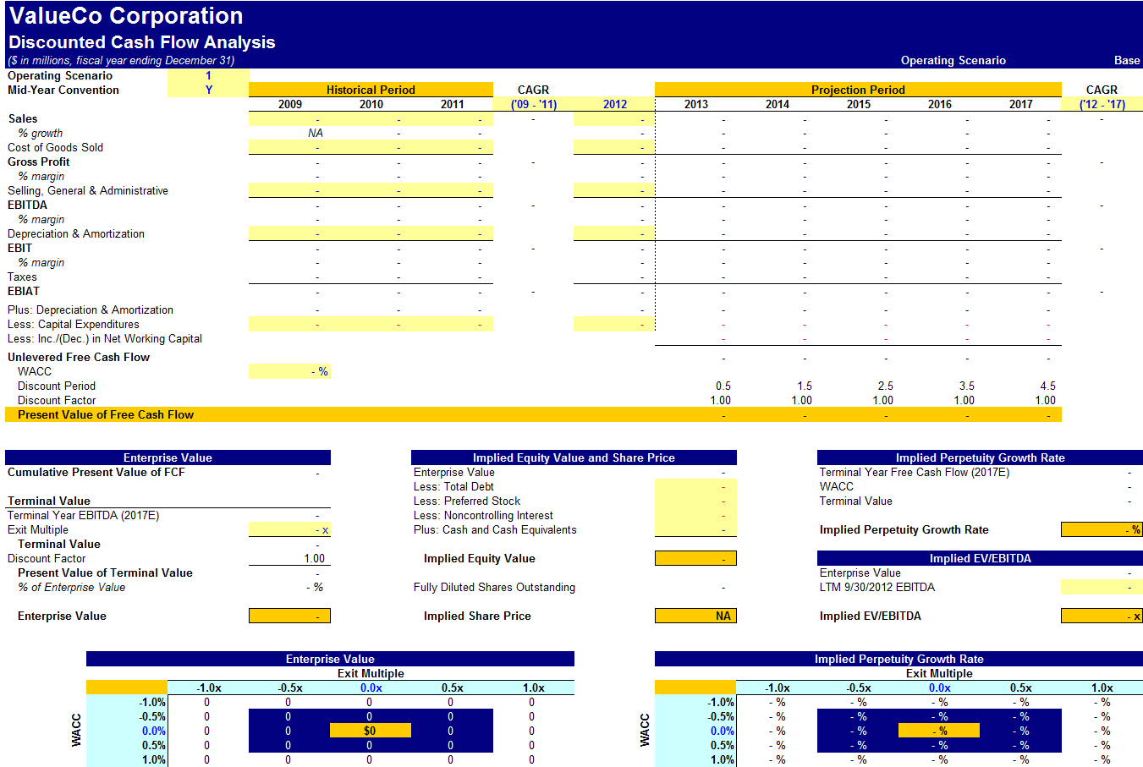
DCF Analysis Output Page (pre)
4

Slide 5
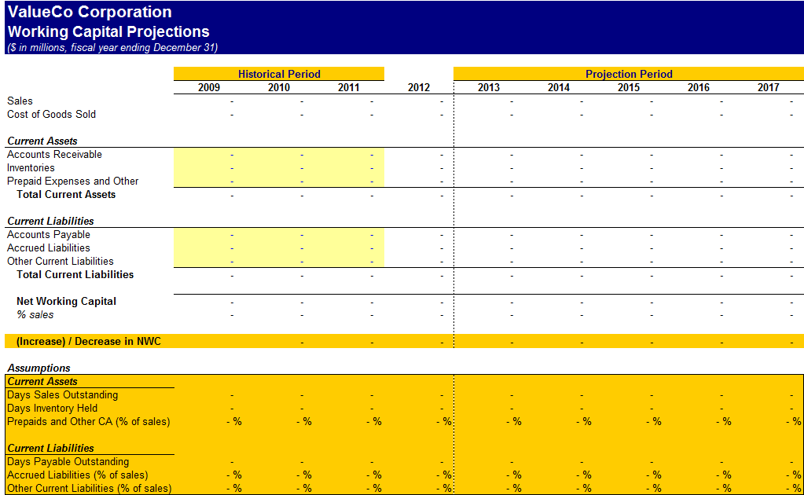
Working Capital Projections (pre)
5

Slide 6
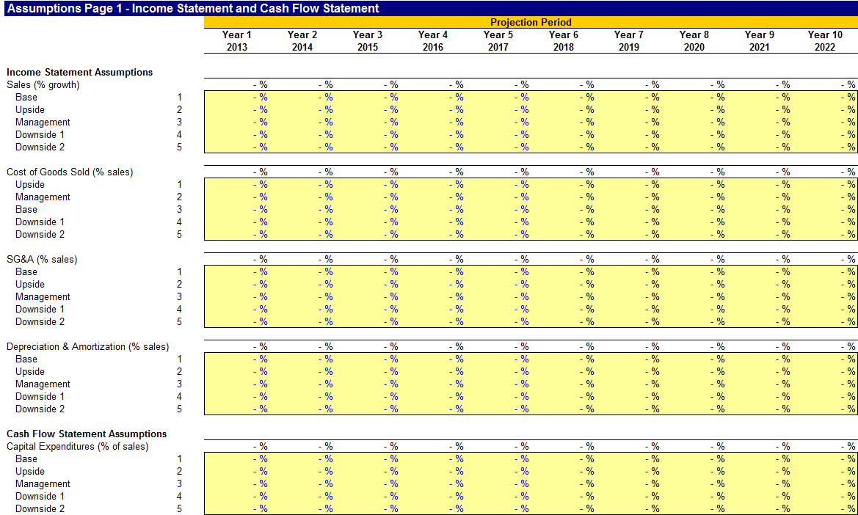
Assumptions Page 1 (pre)
6

Slide 7
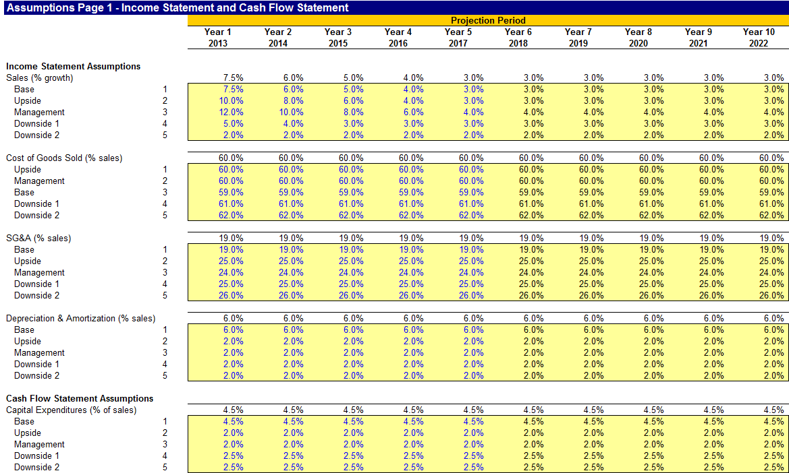
Assumptions Page 1 (post)
7

Slide 8
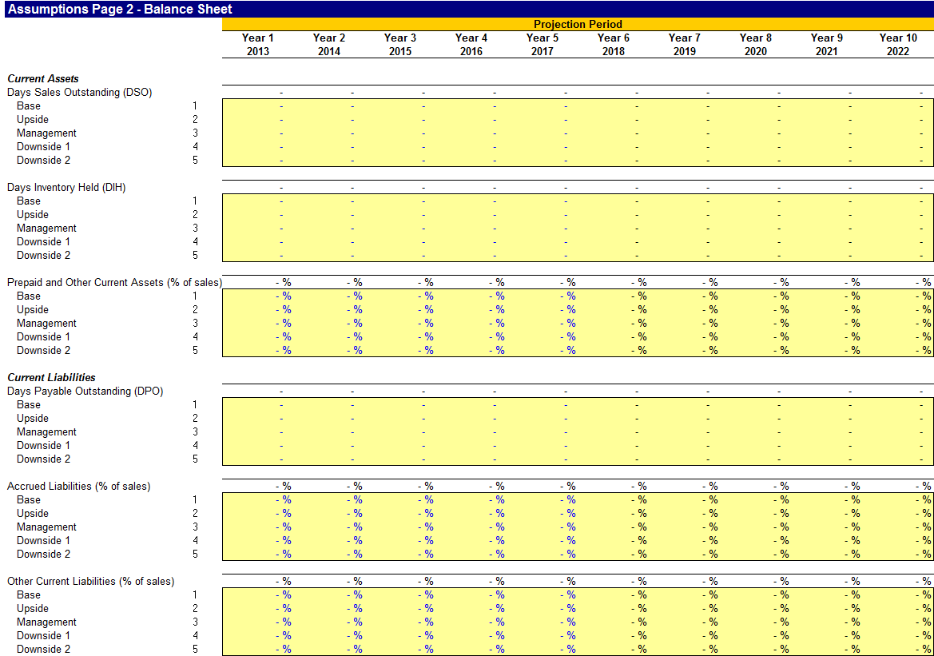
Assumptions Page 2 (pre)
8

Slide 9
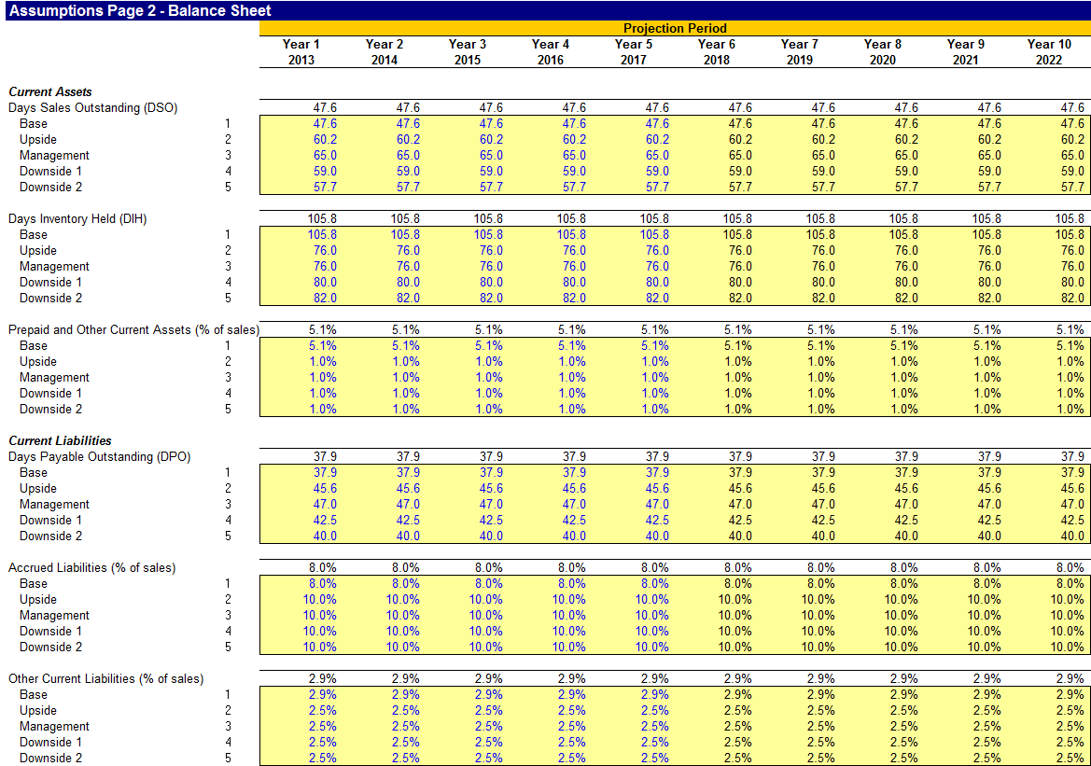
Assumptions Page 2 (post)
9

Slide 10
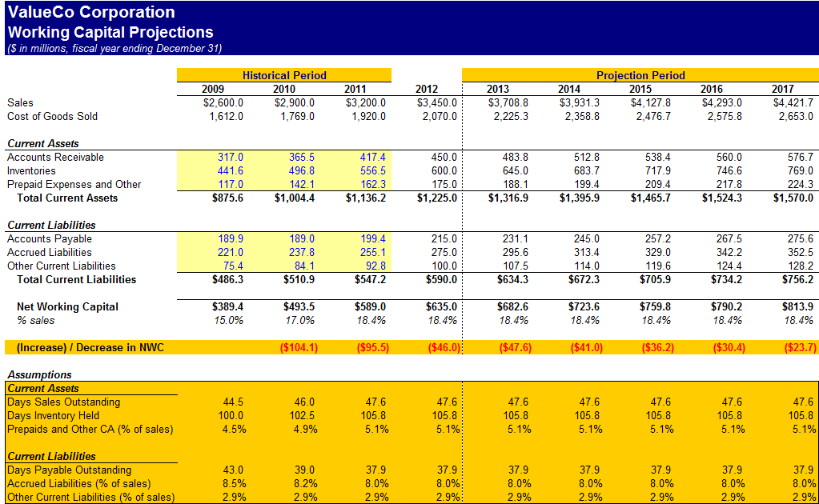
Working Capital Projections (post)
10

Slide 11
WACC and Sensitivities
After completing the inputs for the target’s financial projections, assumptions driving WACC are entered into the WACC tab
The predicted leveraged beta, market value of debt and equity, and marginal tax rate for the target’s closest comparables are entered into the spreadsheet under the Comparable Companies Unlevered Beta heading
The resulting mean unlevered beta combined with the target debt-to-equity ratio and marginal tax rate automatically drive the relevered beta cell
This value links to the WACC calculation, where the target capital structure and assumptions for cost of debt and cost equity are entered into the yellow shaded/blue font boxes
Within the WACC and DCF tabs are sensitivity tables where the final calculated WACC and corresponding valuation can be sensitized
For WACC, the primary sensitized inputs in the spreadsheet are debt-to-total capitalization and pre-tax cost of debt
For the DCF valuation range, key sensitized inputs include the WACC and the exit multiple
11

Slide 12
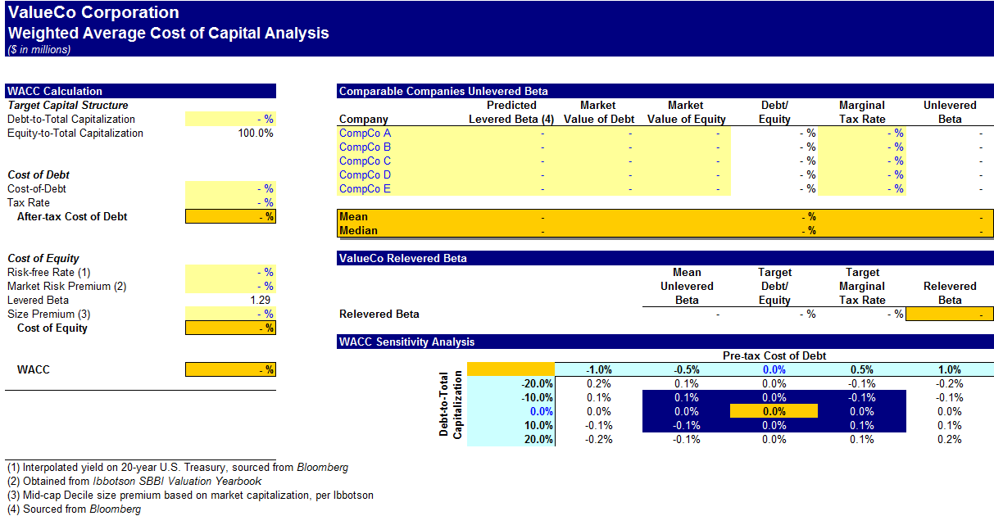
WACC Analysis (pre)
12

Slide 13
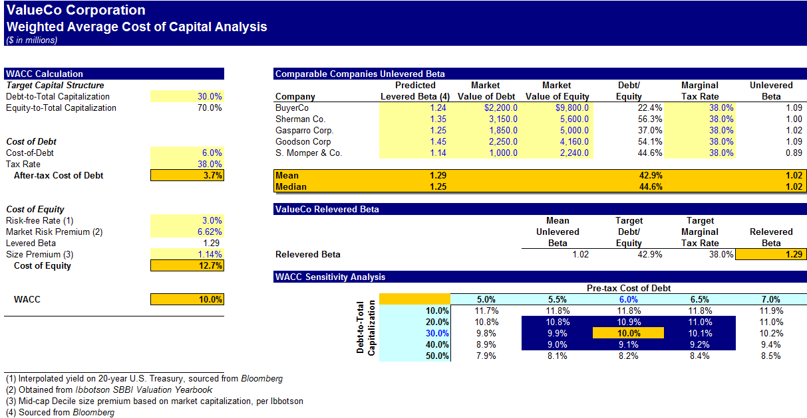
WACC Analysis (post)
13

Slide 14
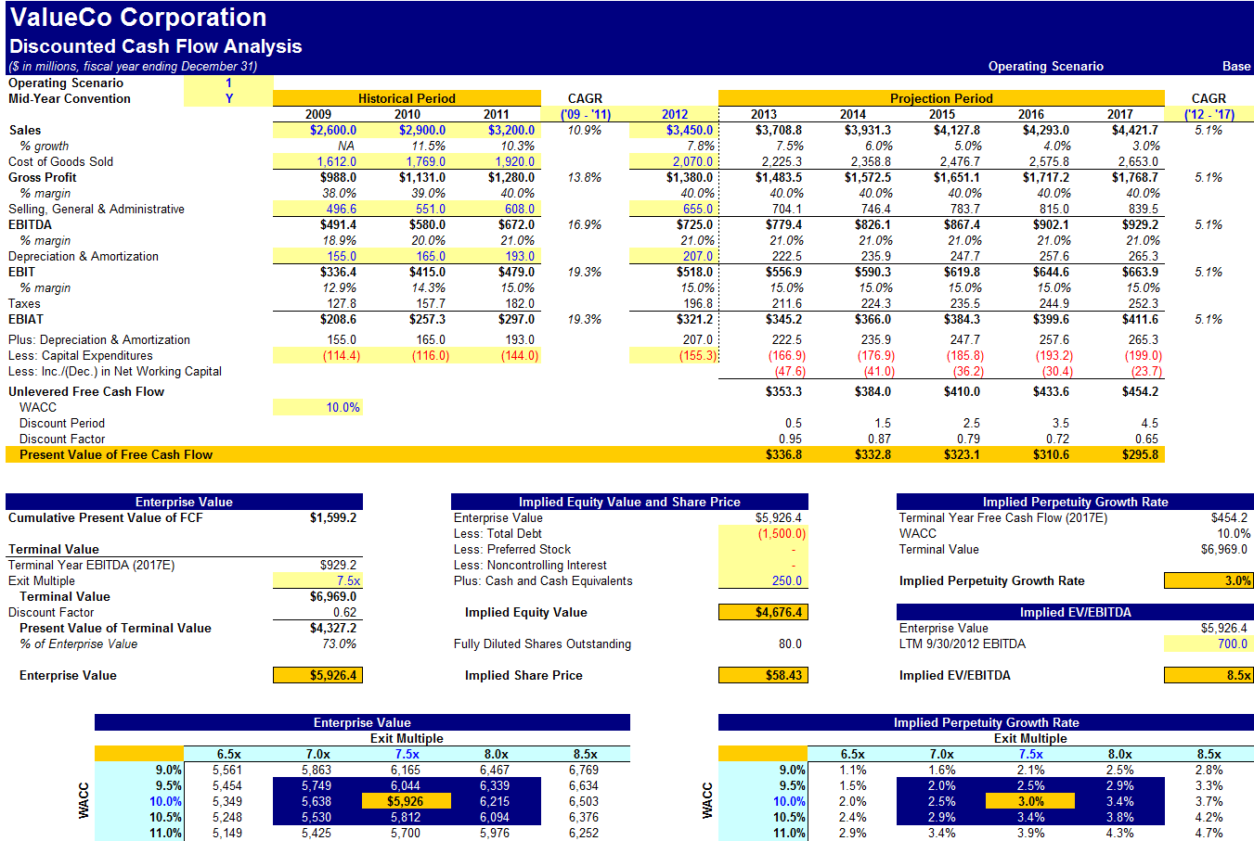
DCF Analysis Output Page (post)
14

Slide 15
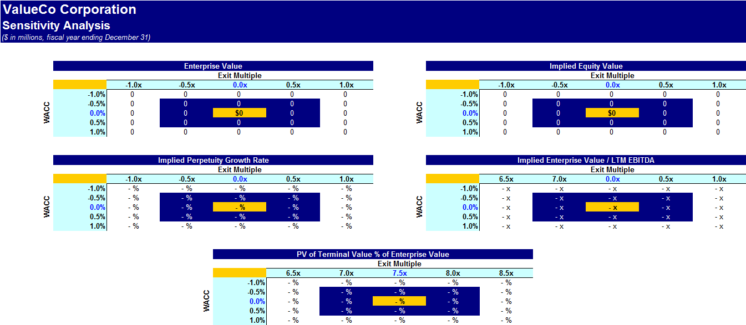
Sensitivity Analysis (pre)
15

Slide 16
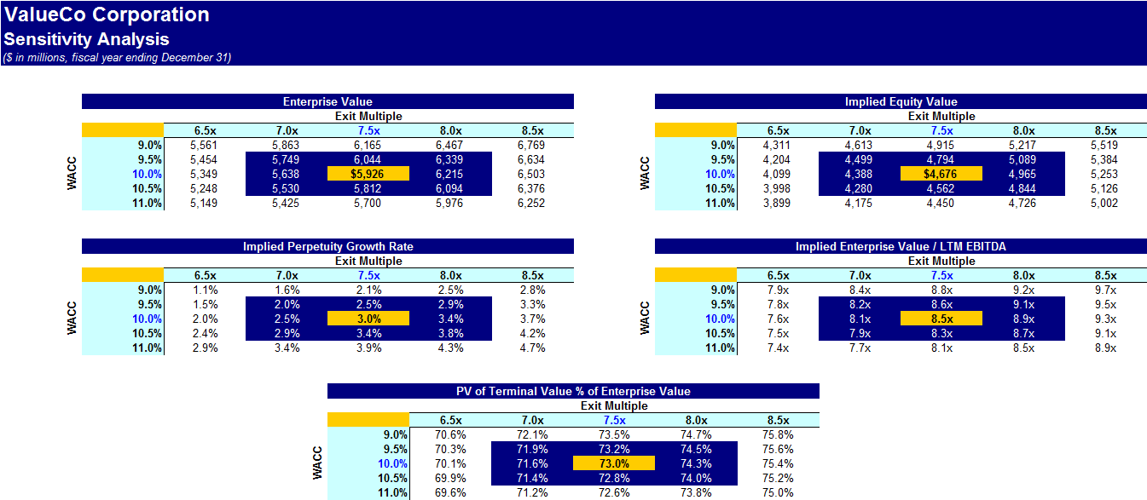
Sensitivity Analysis (post)
16

