Slide 1
International Finance HW4 – FX Market

Slide 2
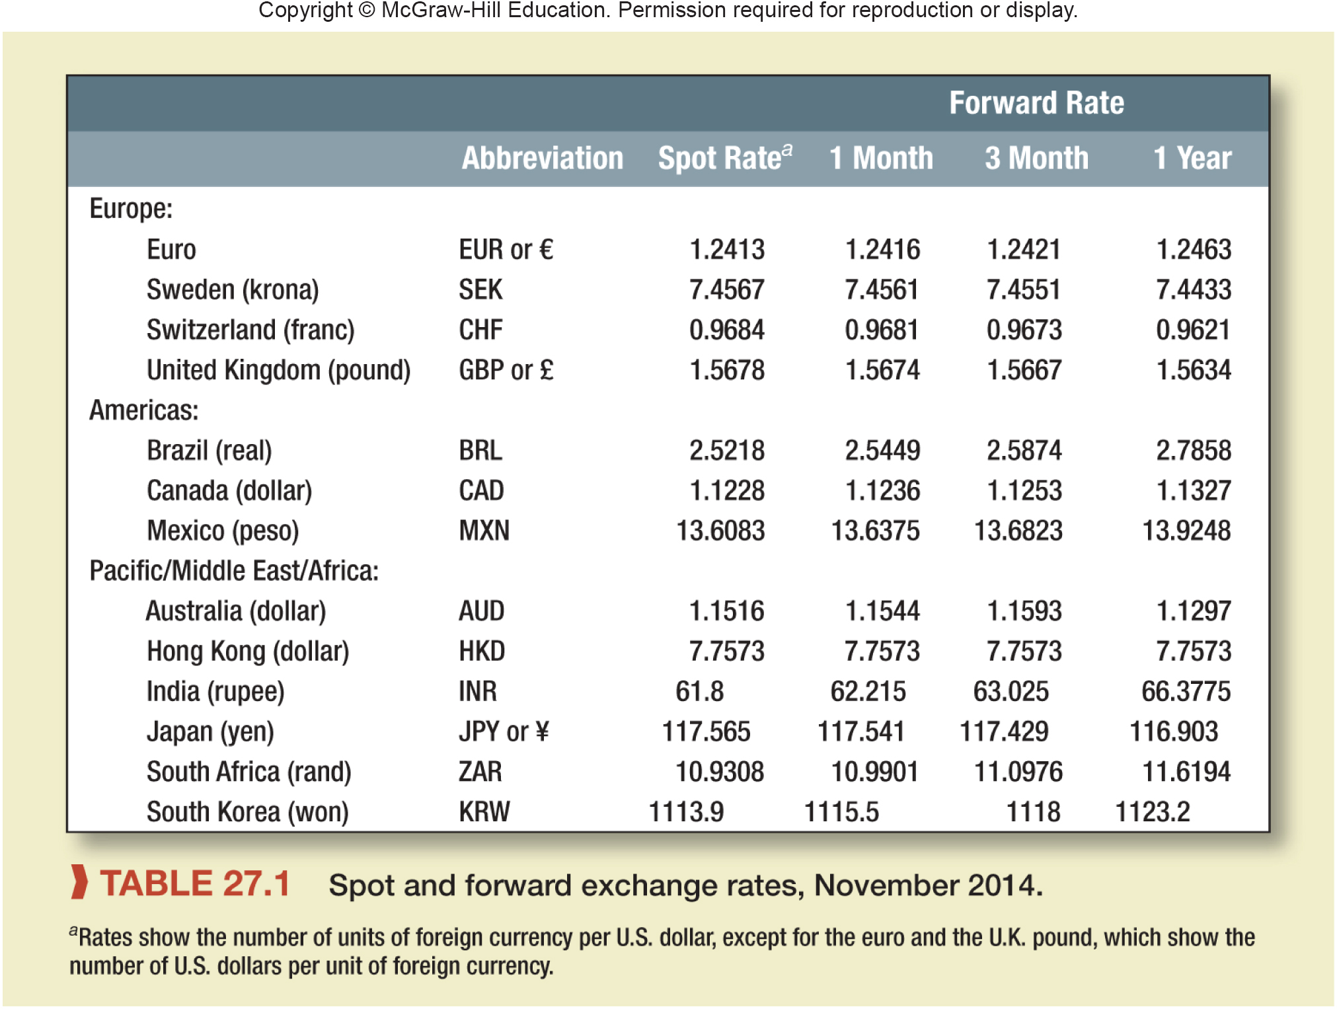
Question
Notes:
a. 117.565
b. 117.541
c. Yen is at premium (dollar is at discount)
d. Premium = 117.565 / 116.903 – 1
Premium = .00566, or .566%
e. From interest rate parity:
116.903 / 117.565 = (1 + ryen) / 1.015
ryen = .00928, or .928%
f. ¥117.429 = $1
g. Assuming the real exchange rate is expected to be constant, the expected difference in inflation is:
117.429 / 117.565 – 1 = –.00116, or –.116%
The inflation rate in Japan over the three months is expected to be .116% less than in the United States.

Slide 3
Questions
Notes:
a. 117.565
b. 117.541
c. Yen is at premium (dollar is at discount)
d. Premium = 117.565 / 116.903 – 1
Premium = .00566, or .566%
e. From interest rate parity:
116.903 / 117.565 = (1 + ryen) / 1.015
ryen = .00928, or .928%
f. ¥117.429 = $1
g. Assuming the real exchange rate is expected to be constant, the expected difference in inflation is:
117.429 / 117.565 – 1 = –.00116, or –.116%
The inflation rate in Japan over the three months is expected to be .116% less than in the United States.

Slide 4
Questions
a. 117.565
Notes:
a. 117.565

Slide 5
Questions
b. 117.541
Notes:
b. 117.541

Slide 6
Questions
c. Yen is at premium (dollar is at discount)
Notes:
c. Yen is at premium (dollar is at discount)

Slide 7
Questions
d. Premium = 117.565 / 116.903 – 1
(Spot/Forward)-1
Premium = .00566, or .566%
Notes:
d. Premium = 117.565 / 116.903 – 1
Premium = .00566, or .566%

Slide 8
Exchange Rate Relationships
Basic Exchange Rate Relationships
r = risk free rate
i = inflation rate
equals
equals
equals
f = forward rate
E = expected spot rate
$$\frac{E\left(S_{{foreign}/\$}\right)}{S_{{foreign}/\$}}$$
equals
S = spot rate
S = spot rate
Notes:
8
7

Slide 9
Questions
e. From interest rate parity:
1+iF/1+i$ = Fwd$/Spot$
116.903 / 117.565 = (1 + ryen) / 1.015
ryen = .00928, or .928%
Notes:
e. From interest rate parity:
1+iF/1+i$ = Fwd$/Spot$
116.903 / 117.565 = (1 + ryen) / 1.015
ryen = .00928, or .928%

Slide 10
Questions
f. ¥117.429 = $1
Notes:
f. ¥117.429 = $1

Slide 11
Questions
g. Assuming the real exchange rate is expected to be constant, the expected difference in inflation is:
1+iF/1+iHOME = FwdHOME/SpotHOME (SEE NEXT SLIDE) {FORGET THE $ SIGN, THING OF THIS AS HOME}
117.429 forward rate/ 117.565 spot rate = CONSTANT (SAME AS BEING 1:1)
117.429 forward rate/ 117.565 spot rate – 1 = INFLATION RATE IN JAPAN
–.00116, or –.116%
THIS IS A FASTER WAY: n2/n1 -1 = percent change OR Forward/Spot -1 = percent change
The inflation rate in Japan over the three months is expected to be .116% less than in the United States.
Notes:
g. Assuming the real exchange rate is expected to be constant, the expected difference in inflation is:
1+iF/1+i$ = Fwd$/Spot$
n2/n1 -1 = percent change
117.429 / 117.565 – 1 = –.00116, or –.116%
The inflation rate in Japan over the three months is expected to be .116% less than in the United States.

Slide 12
Exchange Rate Relationships
3) Purchasing Power Parity
Theory that the cost of living in different countries is equal and that exchange rates adjust to offset inflation differentials across countries.
Notes:
12
16

Slide 13
Solution - summary
a. 117.565
b. 117.541
c. Yen is at premium (dollar is at discount)
d. Premium = 117.565 / 116.903 – 1
Premium = .00566, or .566%
e. From interest rate parity:
116.903 / 117.565 = (1 + ryen) / 1.015
ryen = .00928, or .928%
f. ¥117.429 = $1
g. Assuming the real exchange rate is expected to be constant, the expected difference in inflation is:
117.429 / 117.565 – 1 = –.00116, or –.116%
The inflation rate in Japan over the three months is expected to be .116% less than in the United States.
Notes:
a. 117.565
b. 117.541
c. Yen is at premium (dollar is at discount)
d. Premium = 117.565 / 116.903 – 1
Premium = .00566, or .566%
e. From interest rate parity:
116.903 / 117.565 = (1 + ryen) / 1.015
ryen = .00928, or .928%
f. ¥117.429 = $1
g. Assuming the real exchange rate is expected to be constant, the expected difference in inflation is:
117.429 / 117.565 – 1 = –.00116, or –.116%
The inflation rate in Japan over the three months is expected to be .116% less than in the United States.

Slide 14
Question

Slide 15
a.
First, find the NPV using the euro interest rate of 6%:
NPV = -€80 + 10 / 1.06 + 20 / 1.06² + 23 / 1.06³ + 27 / 1.06⁴ + 25 / 1.06⁵
NPV = €6.61 million
To convert this calculation to dollars, multiply it by the spot exchange rate:
NPV = €6.61 × 1.2 = $7.94 million

Slide 16
b.
The forward rate increases by the interest rate differential each year. The following table shows the forward rates for each of the next five years and adjusts the cash flow in each year.
Year 1: The forward rate = spot rate x (1 + foreign interest rate) / (1 + home interest rate) = 1.2 x (1+.08)/(1+.06)
Year 2: 1.223 x (1.08)/(1+.06) = 1.246
Year 3: 1.246 x (1.08)/(1+.06) = 1.269
etc….

Slide 17
c.
It doesn’t. The company can always hedge against a fall in the euro.

Slide 18
Question

Slide 19
Question

Slide 20
a.
The dollar is selling at a forward premium on the rand.

Slide 21
b.
4 × [(10.9308 spot / 11.0976 forward) – 1] = −0.06012 = −6.012%
Annual percentage discount is 6.012%.
Notes:
????????????
Why isn’t this n2/n1 -1

Slide 22
APPRECIATION/DEPRECIATION OF THE BASE CURRENCY

Slide 23
APPRECIATION/DEPRECIATION OF THE PRICE CURRENCY

Slide 24
c. Using the expectations theory of exchange rates, the forecast is: ZAR 11.0976 = $ 1

Slide 25
d. ZAR100,000 × $1 / ZAR 11.0976 = $9,010.96

Slide 26
Solution – summary
a.
The dollar is selling at a forward premium on the rand.
b.
4 × (10.9308 / 11.0976 – 1) = −0.06012 = −6.012%
Annual percentage discount is 6.012%.
c.
Using the expectations theory of exchange rates, the forecast is: ZAR 11.0976 = $ 1
d.
ZAR100,000 × $1 / ZAR11.0976 = $9,010.96

Slide 27
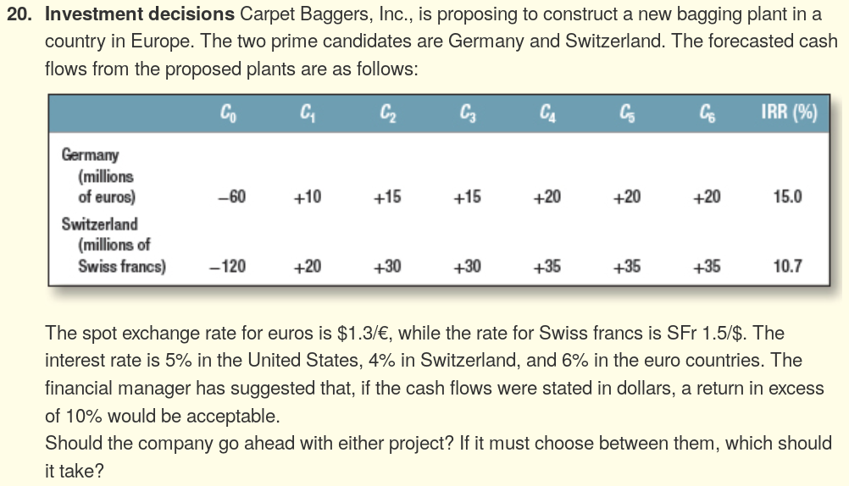
question
Notes:
Converting the cash flows to dollars, the NPVs are computed as:
NPV_{G} = –78 + 12.877 / 1.1 + 19.134 / 1.1^2 + 18.953 / 1.1^3 + 25.033 / 1.1^4 + 24.797 / 1.1^5 + 24.563 / 1.1^6
NPV_{G} = $10.12
NPV_{S} = –80 + 13.462 / 1.1 + 20.386 / 1.1^2 + 20.582 / 1.1^3 + 24.244 / 1.1^4 +24.477 / 1.1^5 + 24.712 / 1.1^6
NPV_{S} = $10.26
Since both projects have a positive NPV, both should be accepted. If the firm must choose, then the Swiss plant is the better choice. Note that the NPV calculation is in dollars and implicitly assumes currency hedging.

Slide 28
STEP 1: FORECAST THE FORWARD RATE OF THE DOLLAR
Year 1: The forward rate = spot rate x (1 + foreign interest rate) / (1 + home interest rate) = 1.3 x (1+.05)/(1+.06) = 1.288
Year 2: 1.288 x (1.05)/(1+.06) = 1.276
Year 3: 1.276 x (1.05)/(1+.06) = 1.264
etc….
STEP 2: CONVERT THE EURO CASH FLOWS TO DOLLARS
DAY 1: -60 x 1.3 = 78
Year 1: 10*1.288 = 12.88
Year 2: 15 x 1.276 = 1.276
Year 3: 1.276 x (1.05)/(1+.06) = 1.264
etc….

Slide 29
Converting the cash flows to dollars, the NPVs are computed as:
STEP 3. CALCULATE THE NPV USING THE 10% DISCOUNT FACTOR GIVEN!
NPV_{G} = –78 + 12.877 / 1.1 + 19.134 / 1.1^2 + 25.271 / 1.1^3 + 25.033 / 1.1^4 + 24.797 / 1.1^5 + 24.563 / 1.1 ^6
NPV_{G} = $10.12
STEP 4: DO THE SAME AS THE ABOVE THREE STEPS BUT CONVERT THE SWISS FRANC CF’S TO USD. YOU MUST FIRST FORECAST THE SWISS FRANC FORWARD RATE.
NPV_{S} = –80 + 13.462 / 1.1 + 20.386 / 1.1^2 + 20.582 / 1.1^3 + 24.244 / 1.1^4 +24.477 / 1.1^5 + 24.712 / 1.1^6
NPV_{S} = $10.26
Since both projects have a positive NPV, both should be accepted. If the firm must choose, then the Swiss plant is the better choice. Note that the NPV calculation is in dollars and implicitly assumes currency hedging.

